Slide 1
Unveiling the Spectrum of Rest :
Exploring Seven Transformative Dimensions
Vaishnavi V

Slide 2
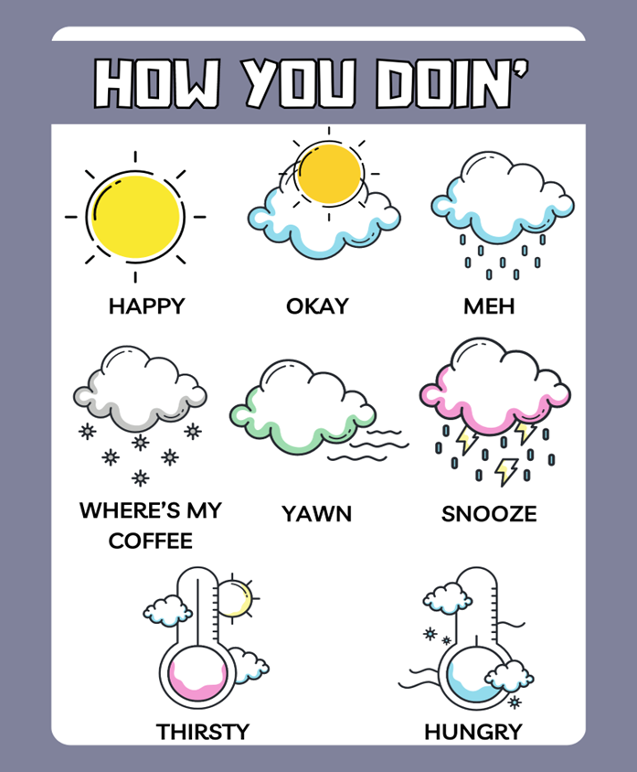
Notes:
Joey Tribbiani from the sitcom Friends

Slide 3
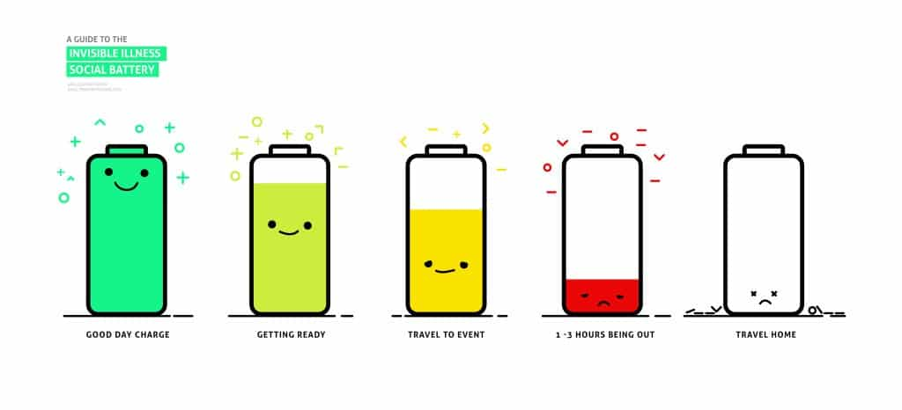
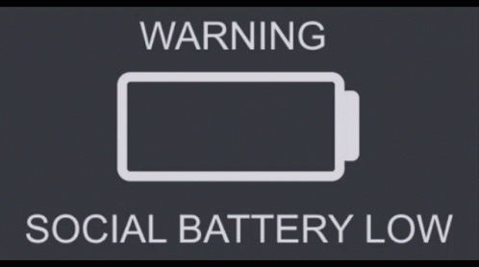

Slide 4


Slide 5
Glossophobia

Slide 6


Slide 7
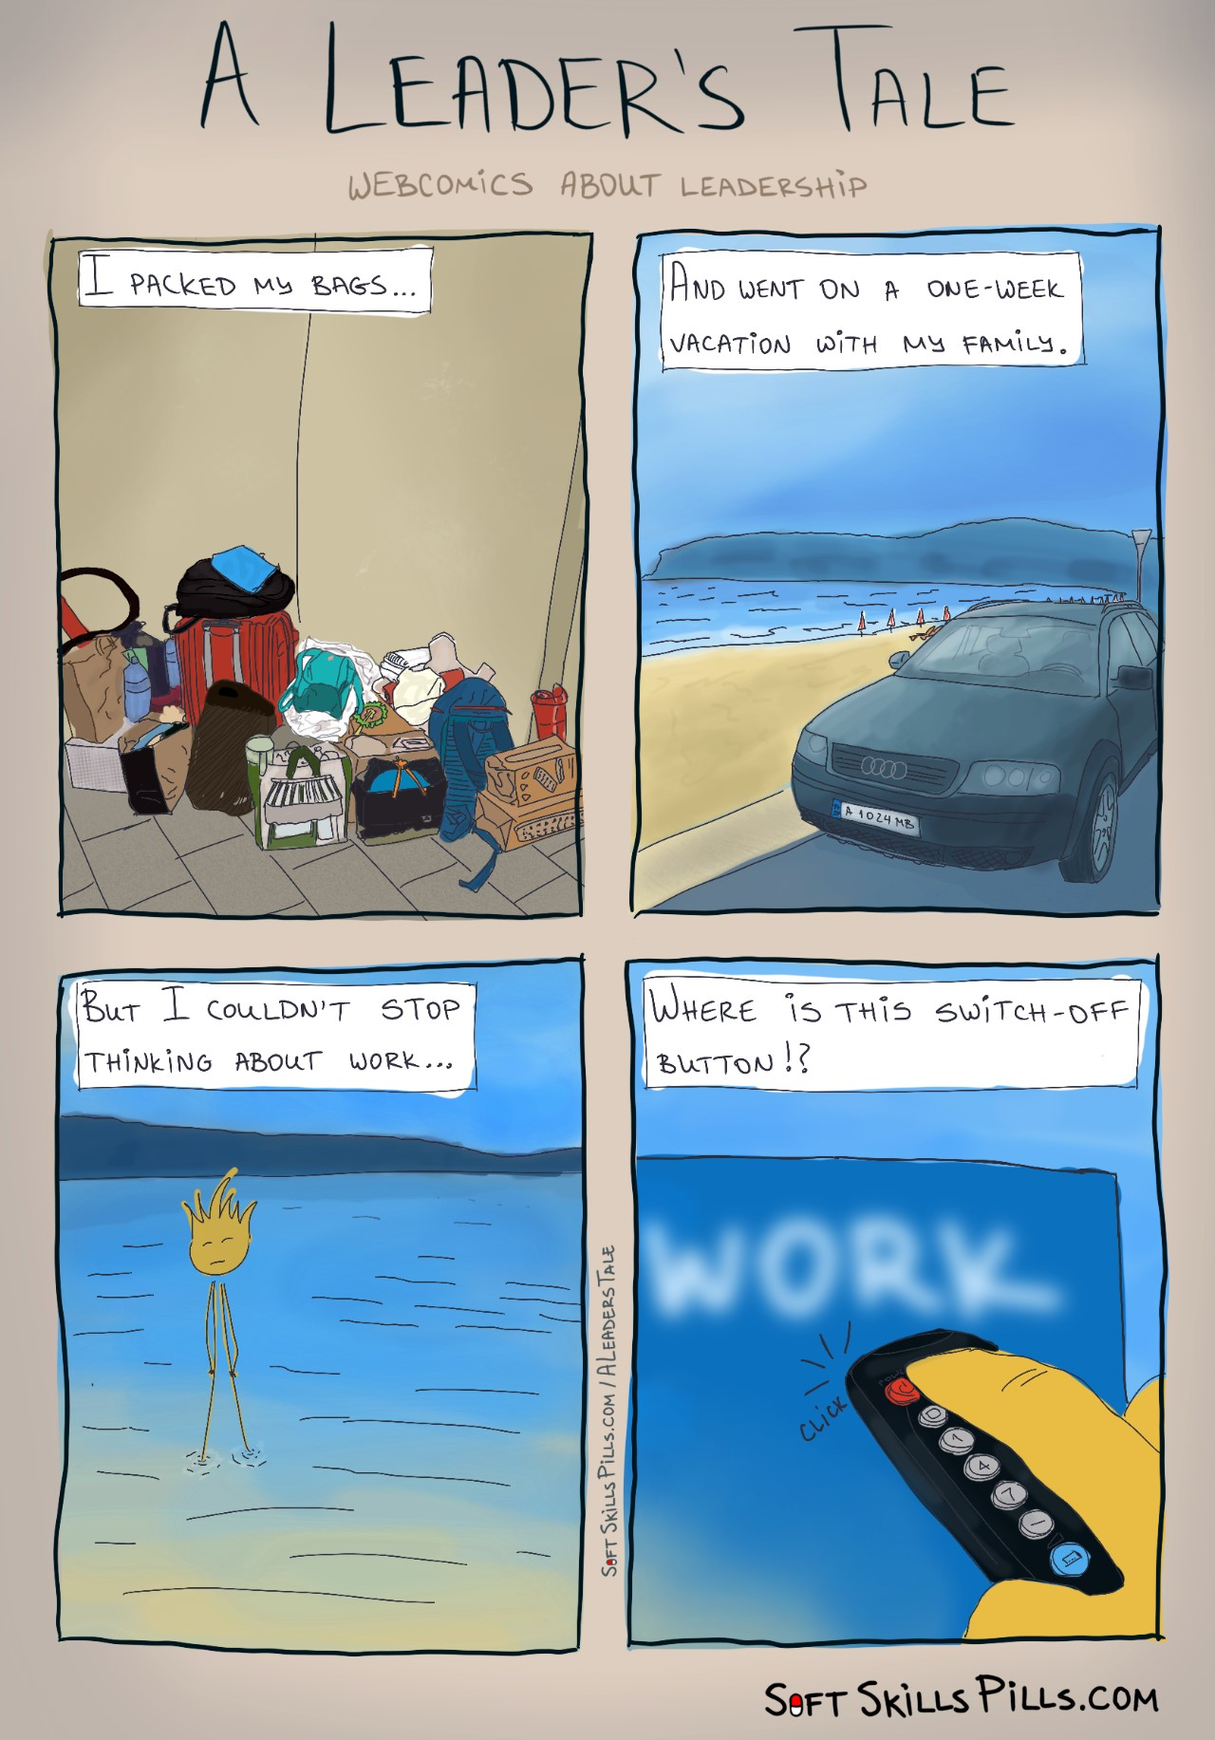

Slide 8
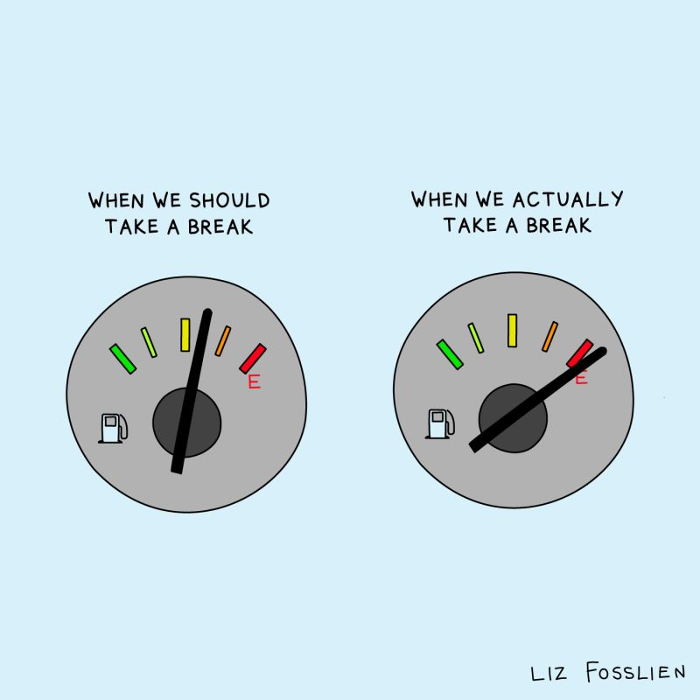
PROACTIVE vs REACTIVE

Slide 9
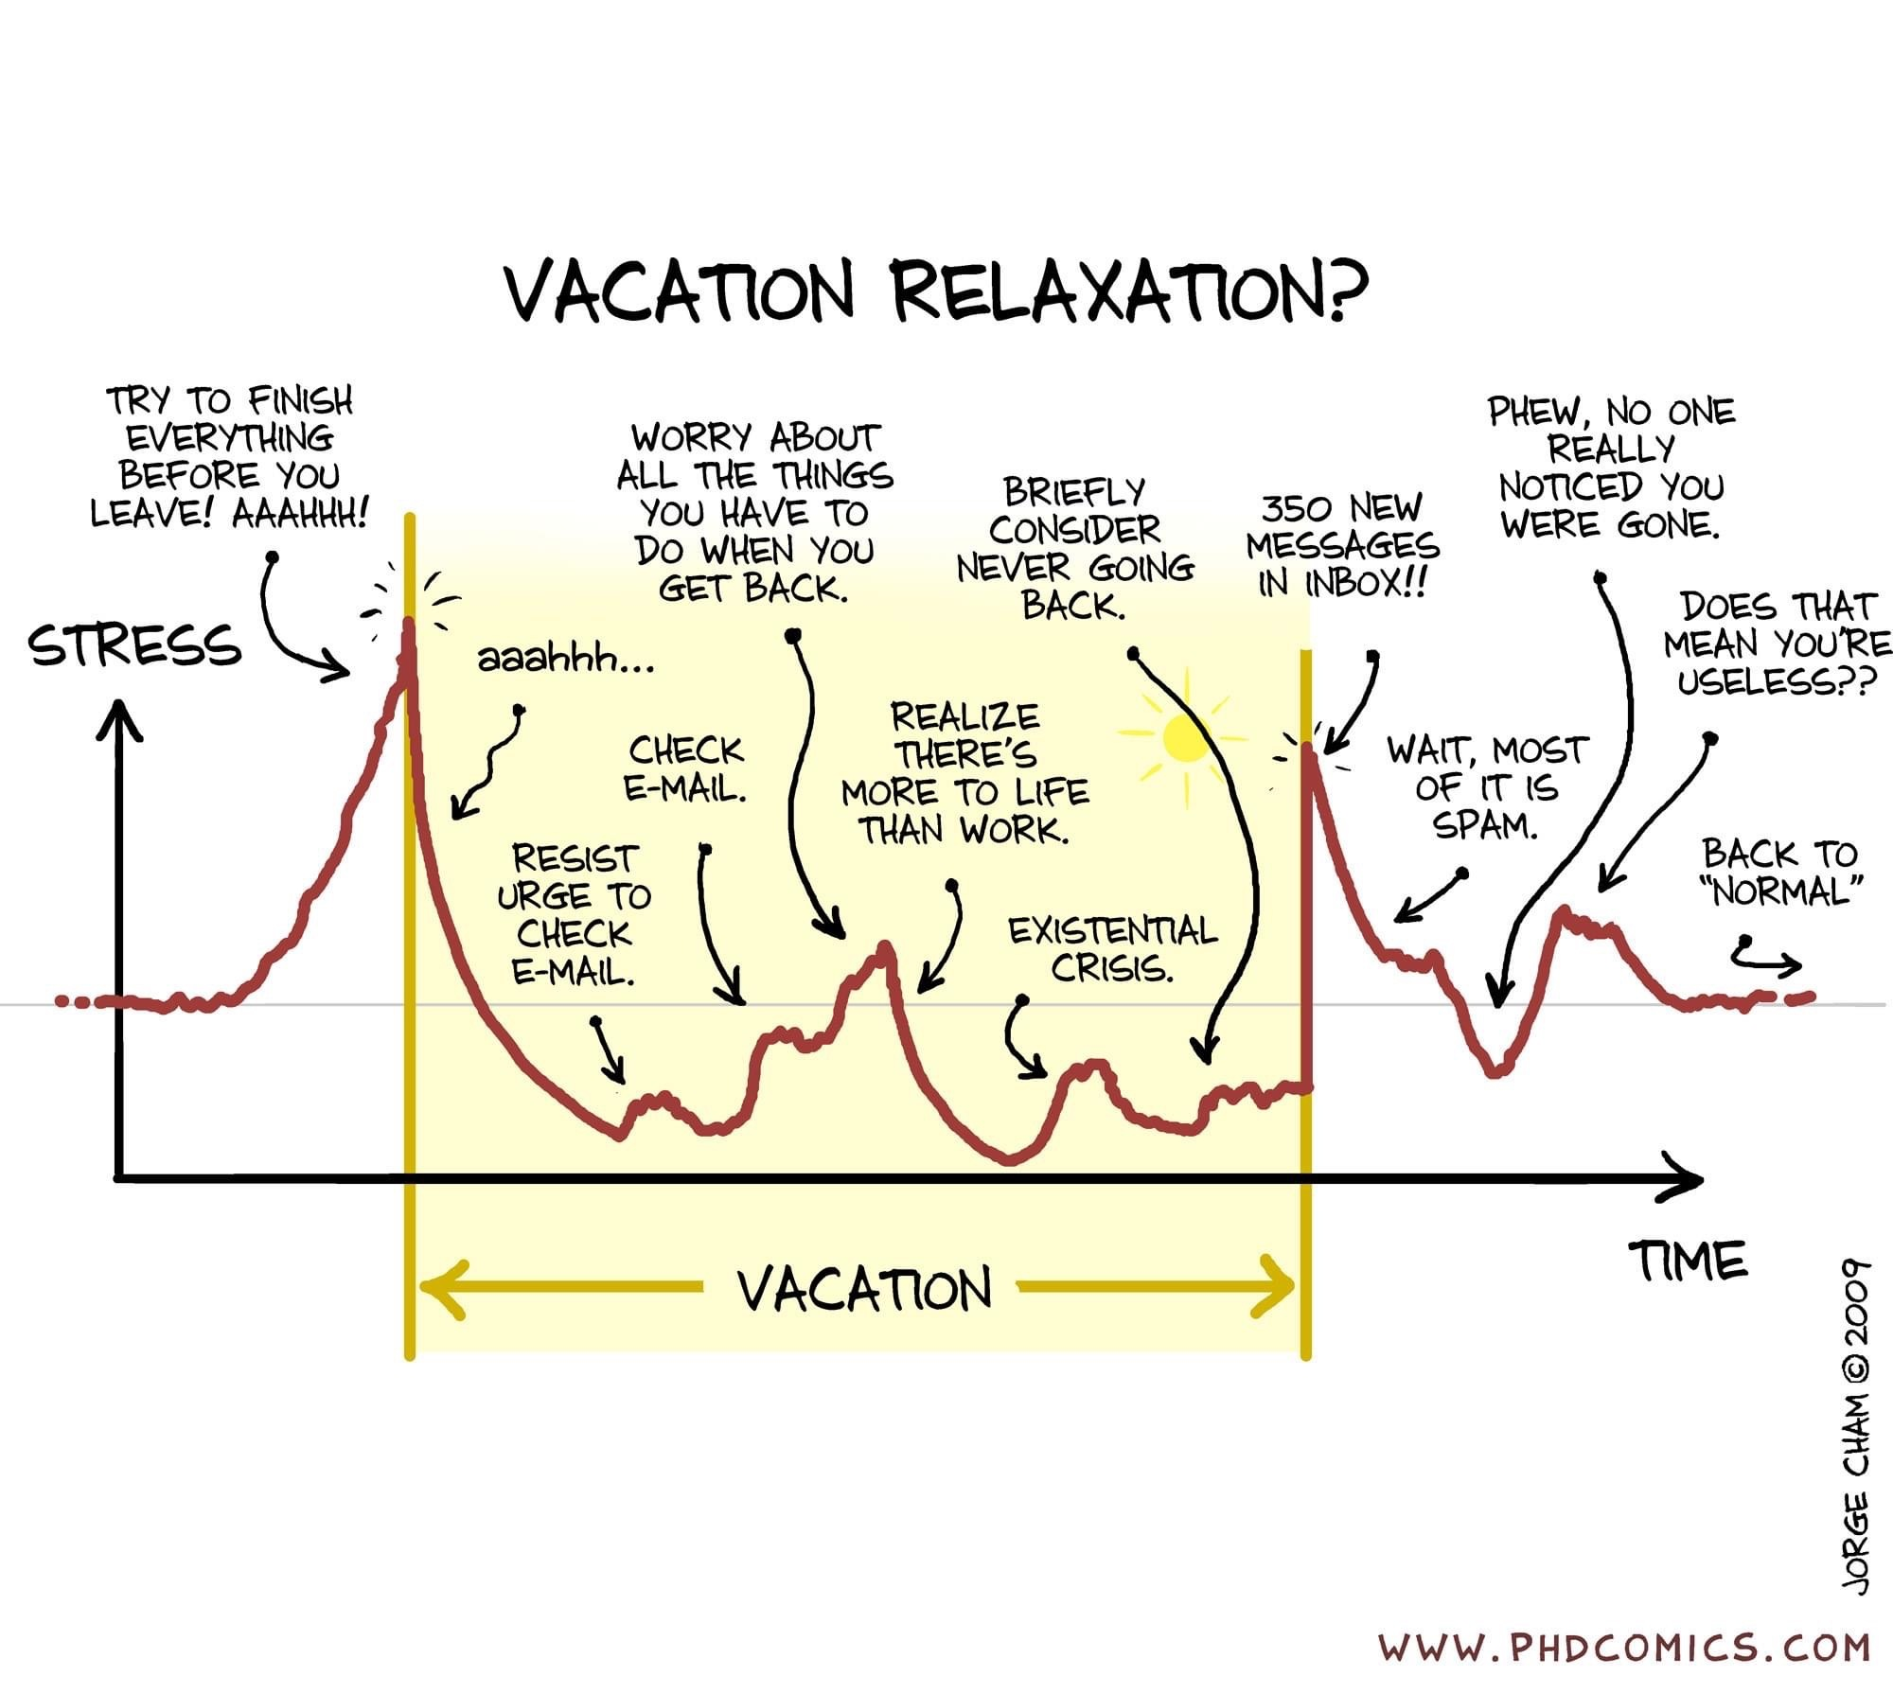

Slide 10
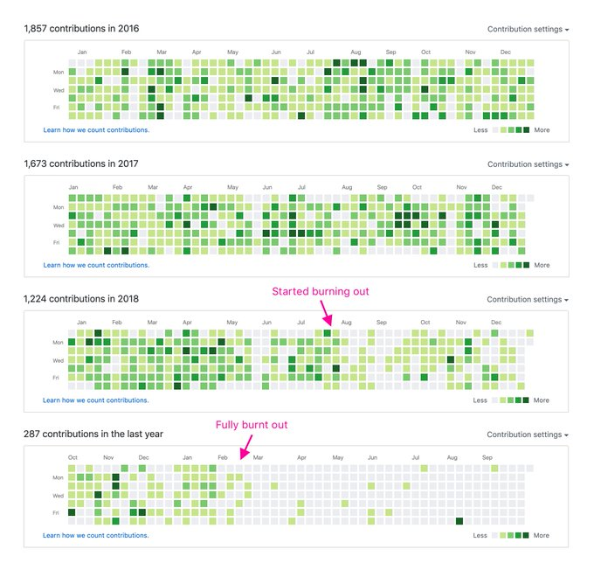
Visualizing burnout.
Credits : Jonnie Hallman

Slide 11
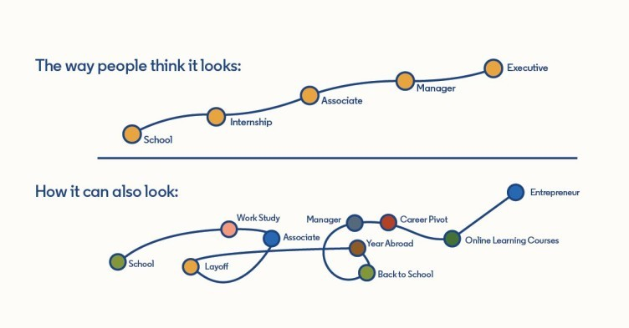
EXPECTATIONS vs REALITY

Slide 12
The name 996.ICU refers to "Work by '996', sick in ICU", an ironic saying among Chinese developers, which means that by following the "996" work schedule, you are risking yourself getting into the ICU (Intensive Care Unit).
Visit : https://github.com/996icu/996.ICU

Slide 13
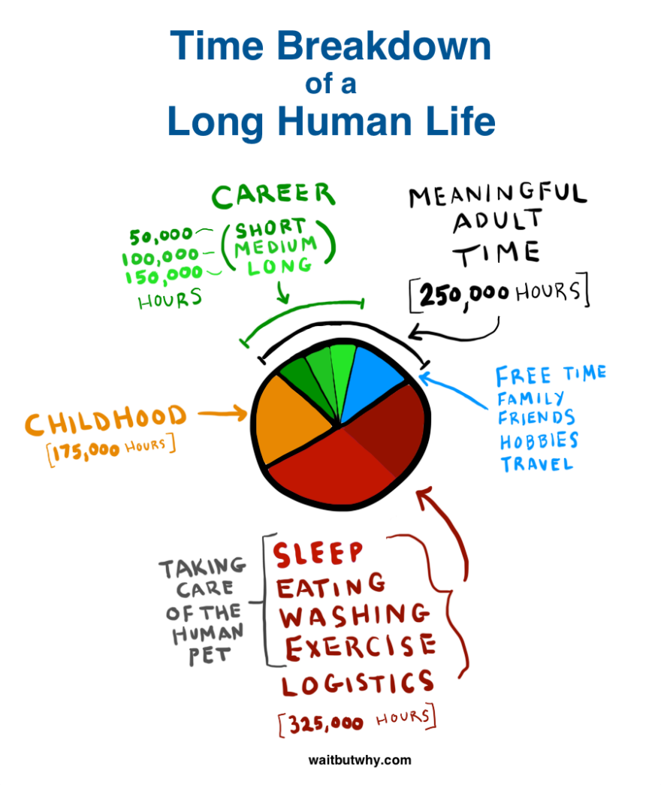

Slide 14

SPOON THEORY

Slide 15
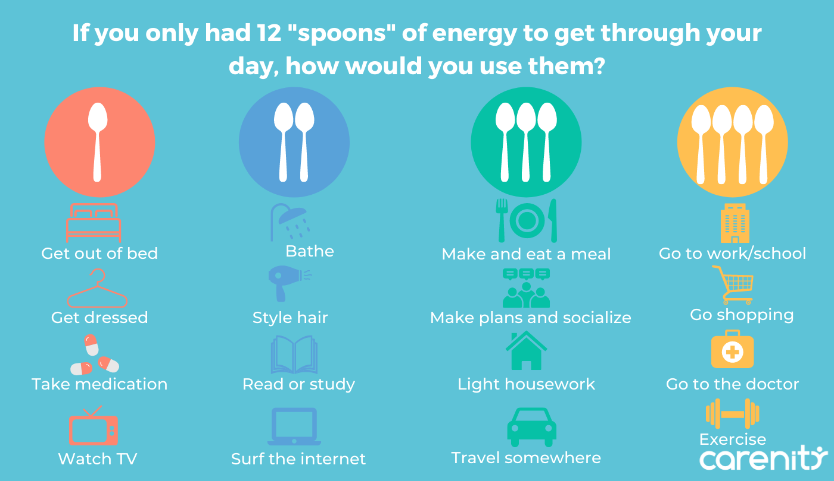

Slide 17

SLEEP ≠ REST
1/7

Slide 18


REST
Underused
Chemical Free
Safe
Effective
Alternative form of therapy

Slide 19



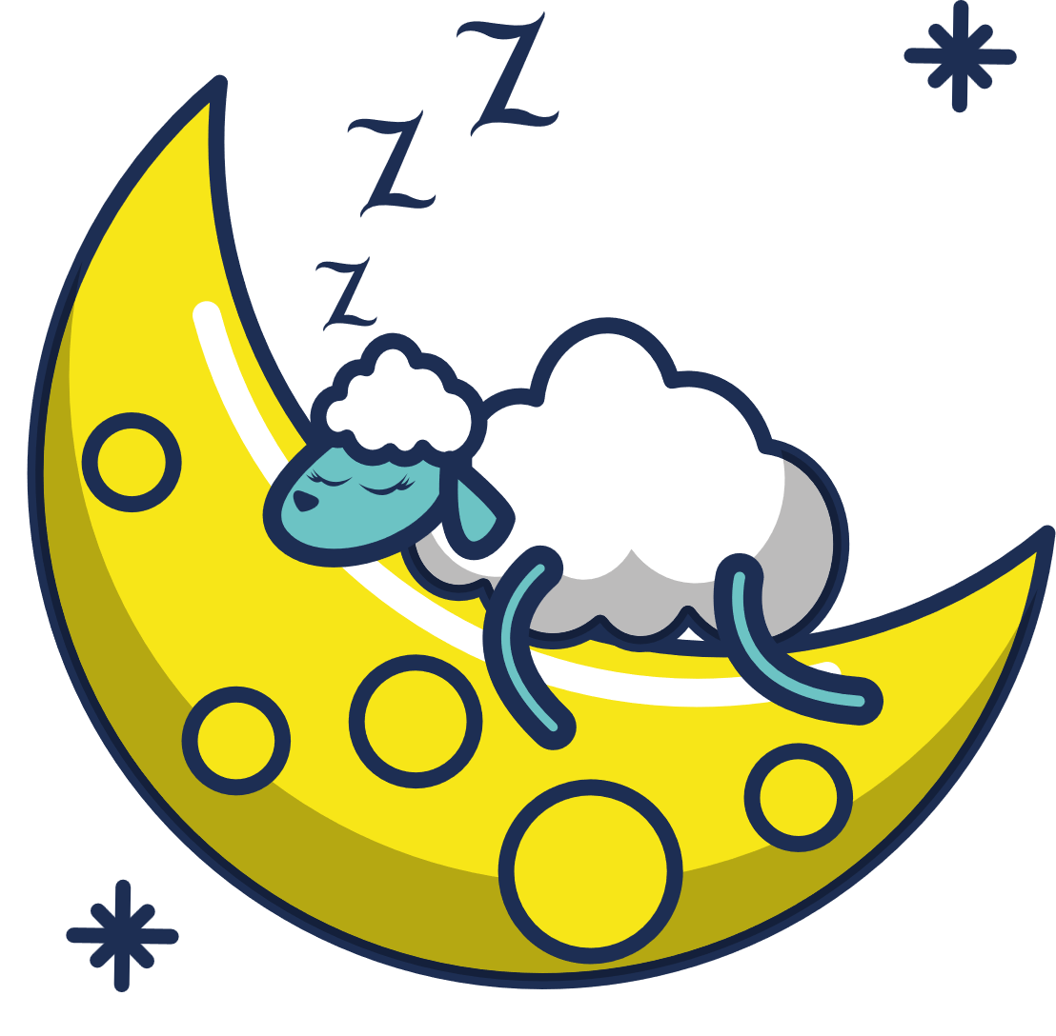



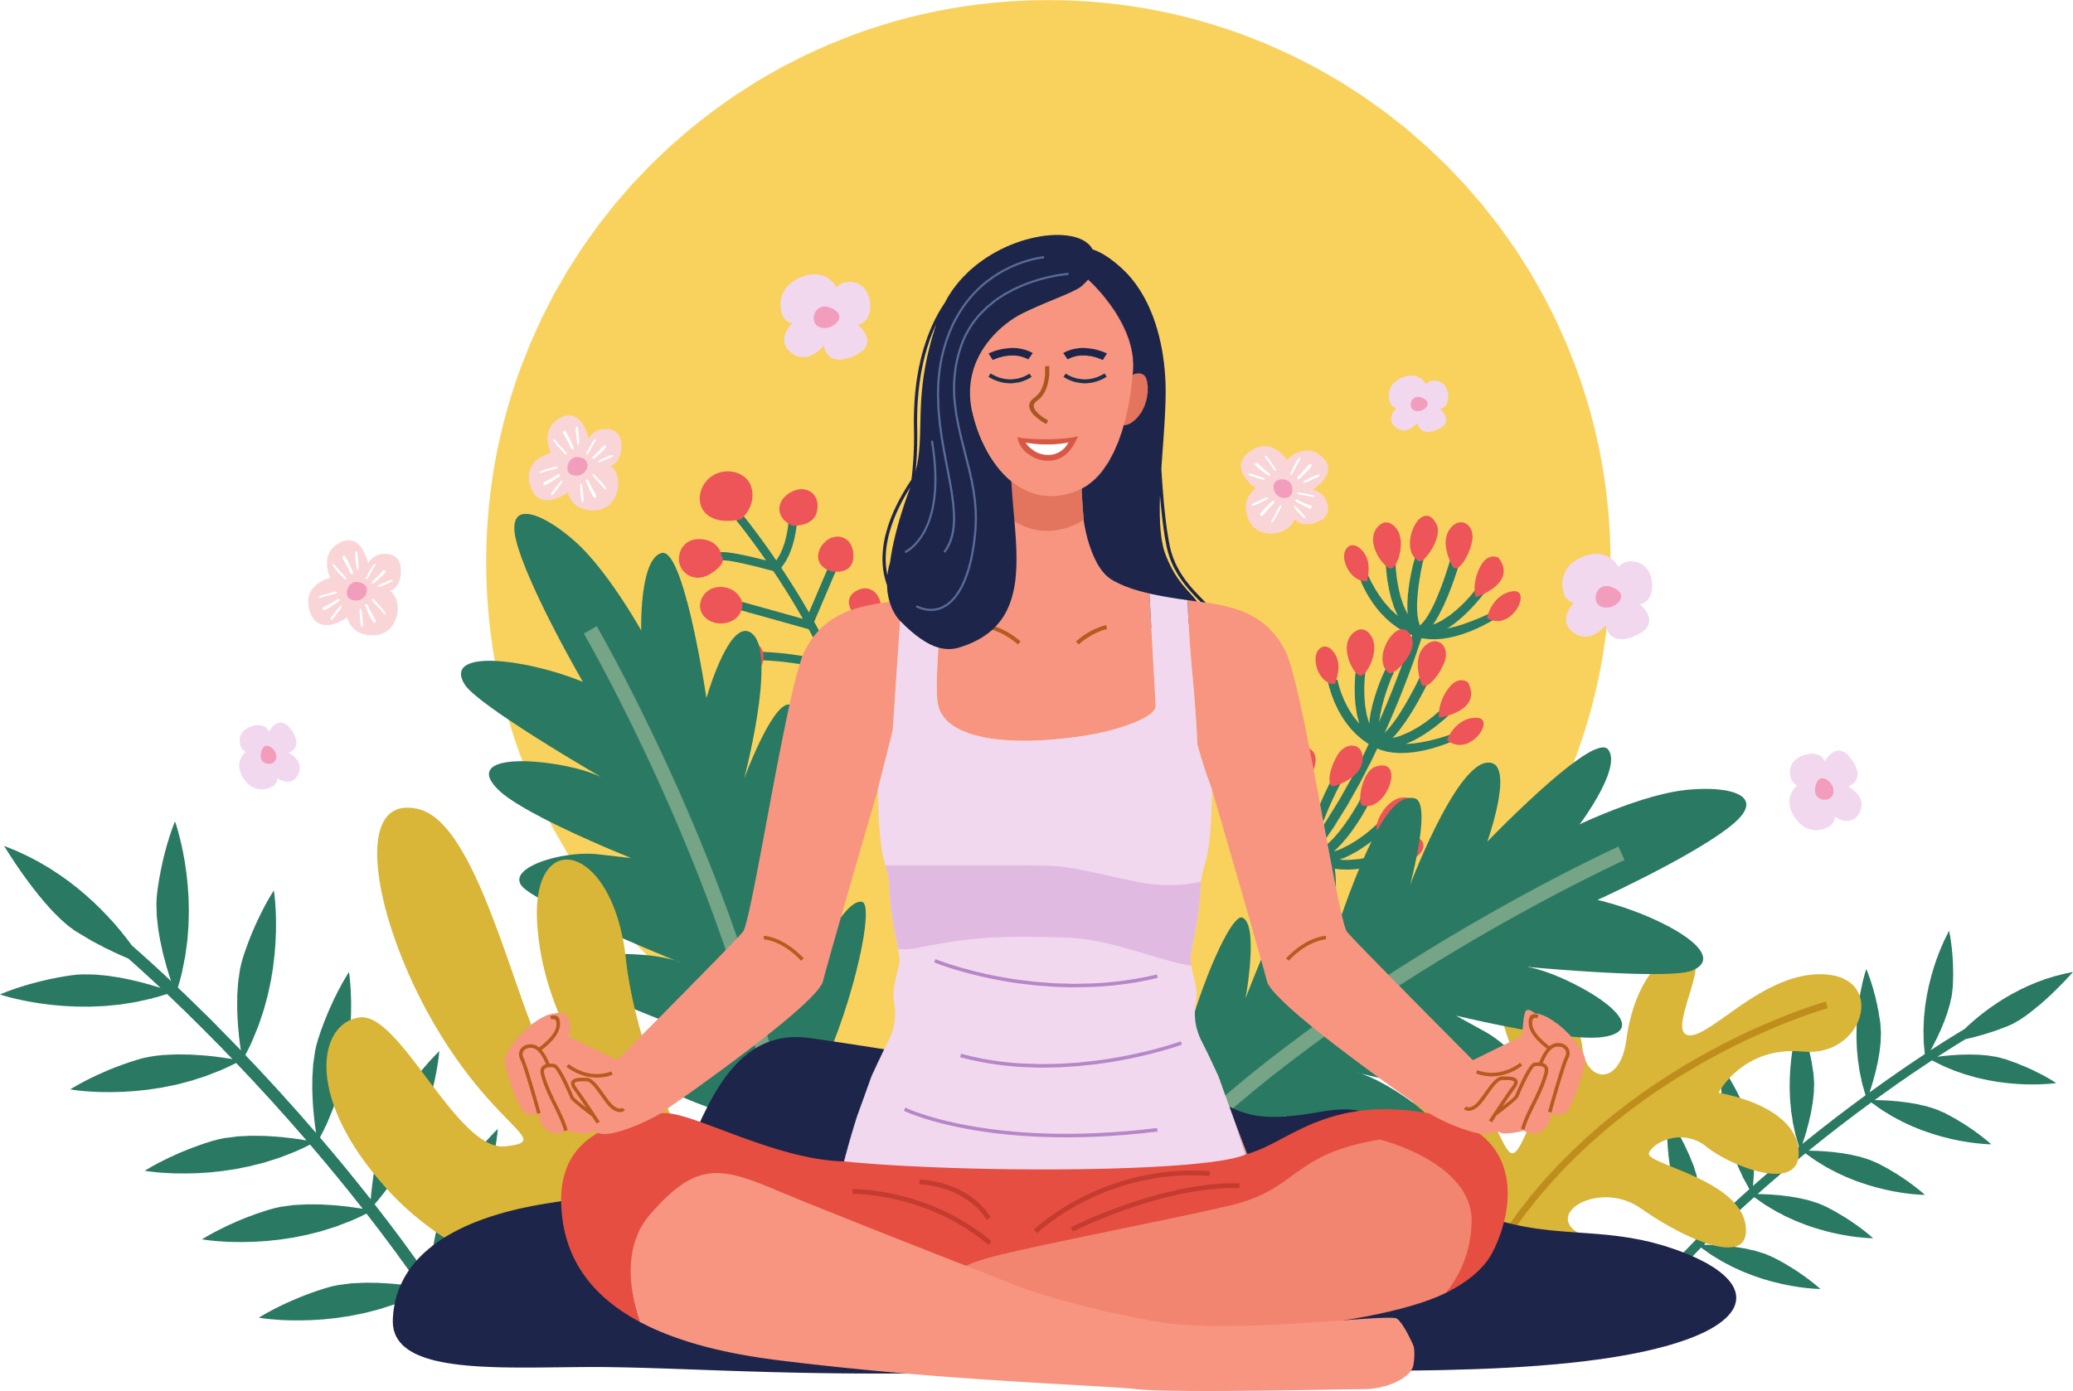




7 types of Rest
Physical Rest
Emotional Rest
Mental Rest
Spiritual Rest
Sensory Rest
Creative Rest
Social Rest

Slide 20

Physical Rest
Lack of sleep and overtraining deplete your body's energy.
Physically drained

Slide 21
Physical Rest
Passive
Sleep 7+ hrs. nightly
Take power naps (as needed)
Active
Restorative activities
Massage improve the body’s circulation and flexibility
Yoga, massage, using a foam roller, regular stretch breaks, adjusting workspace ergonomics

Slide 22
stretching
taking a nap
getting a massage
taking short breaks
going for a walk
When we rest physically, we give our muscles time to repair and recover, which helps us avoid injuries and reduces fatigue

Slide 23

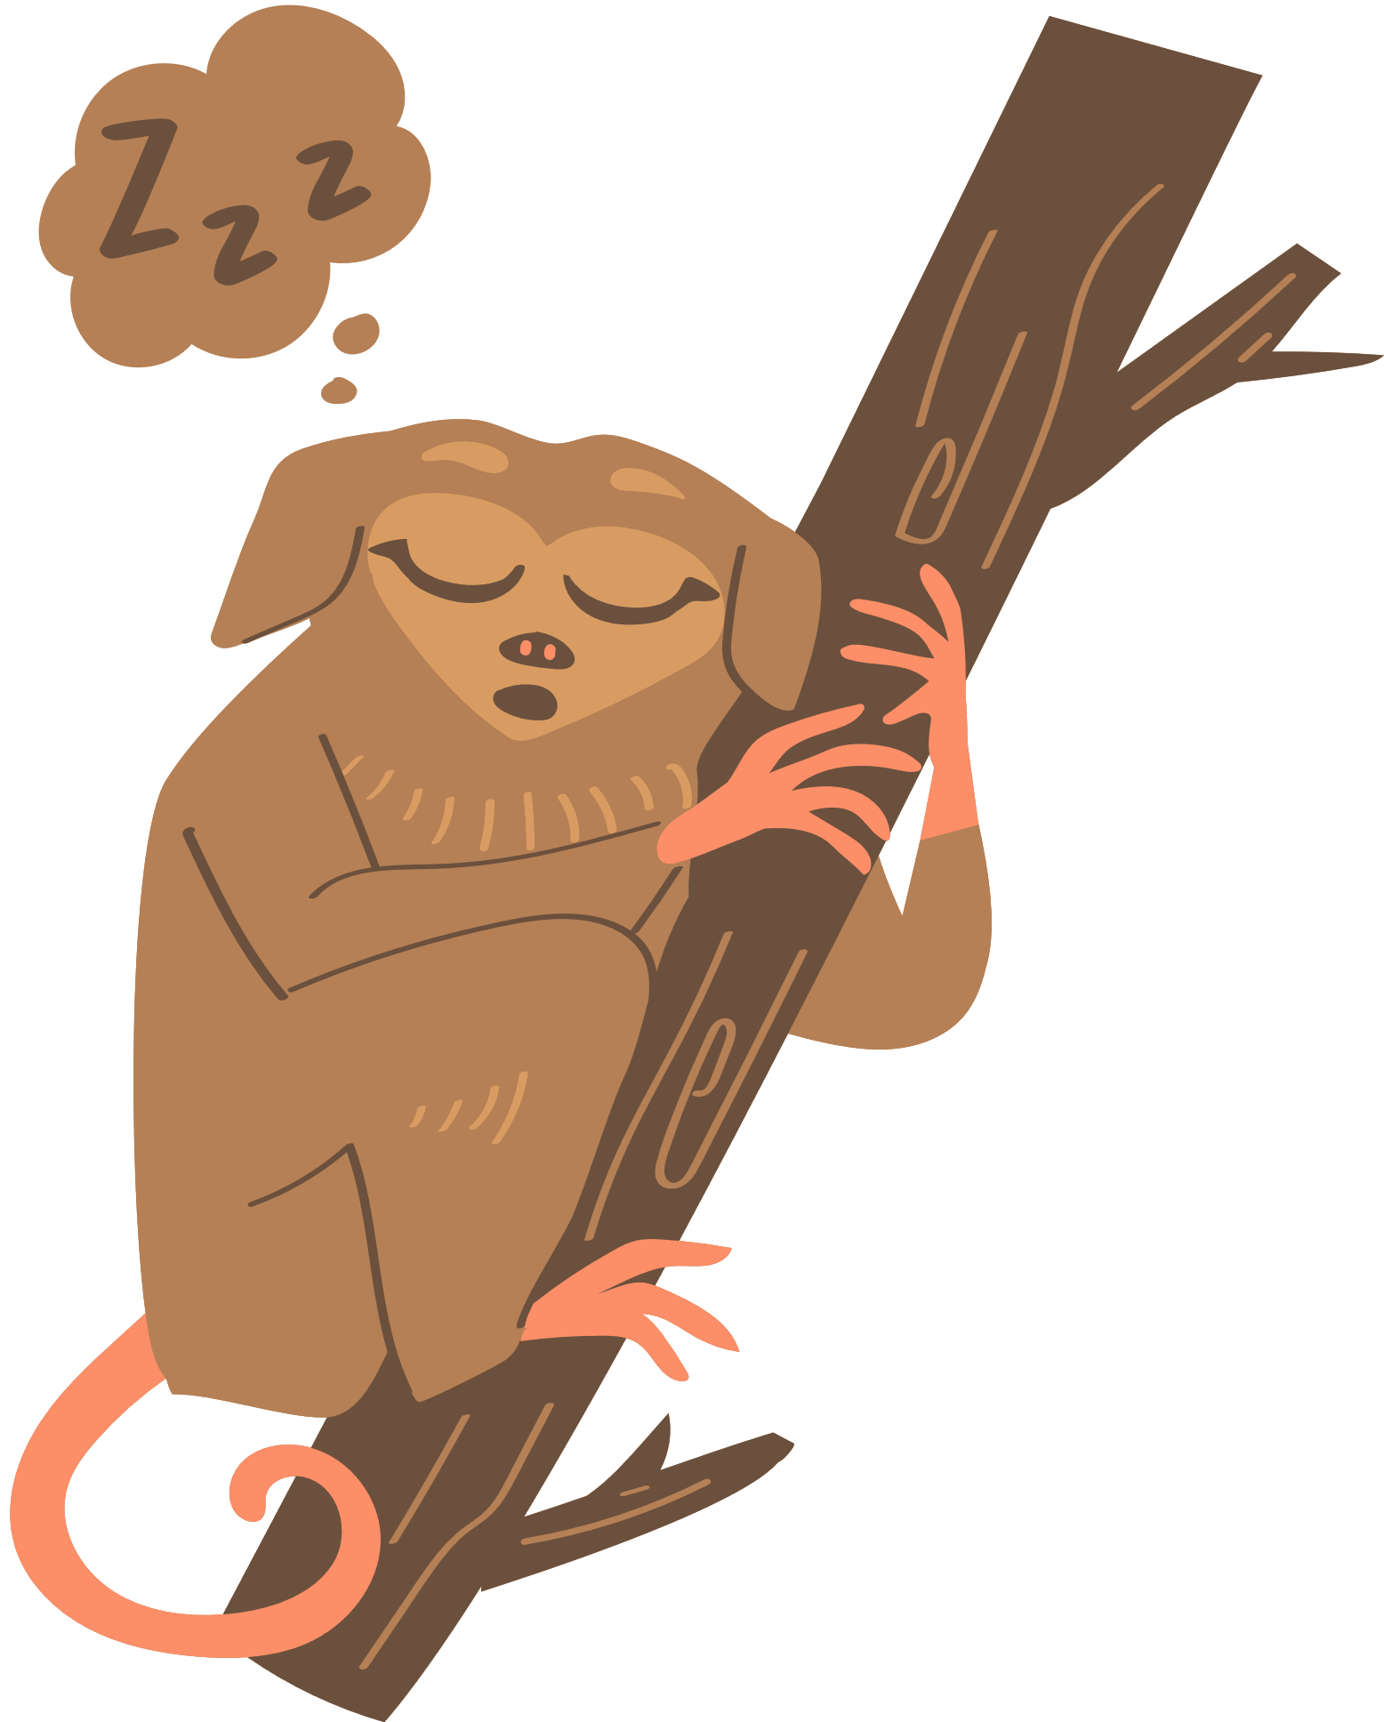

Physical Rest
Lack of sleep and overtraining deplete your body's energy.
Passive
Sleep 7+ hrs. nightly
Take power naps (as needed)
Active
Restorative activities
Massage improve the body’s circulation and flexibility

Slide 24


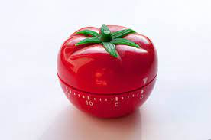


Mental Rest
Mental rest deficit is caused by overtaxing your thinking.
Create a shutdown ritual to separate work and life
Notepad by the bed for nagging thoughts
Take a break from problem-solving
Brain-breaks (Schedule them. Use Pomodoro)
Music, silence, journaling
Notes:
You might also keep a notepad by the bed to jot down any nagging thoughts that would keep you awake

Slide 25
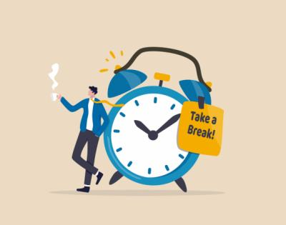
Mental Rest
Mental rest deficit is caused by overtaxing your thinking (Brain fog).
If your occupation draws primarily on your mental resources, you may find that tiredness comes in the form of loss of concentration, cynicism, irritation, apathy
Notes:
You might also keep a notepad by the bed to jot down any nagging thoughts that would keep you awake

Slide 26
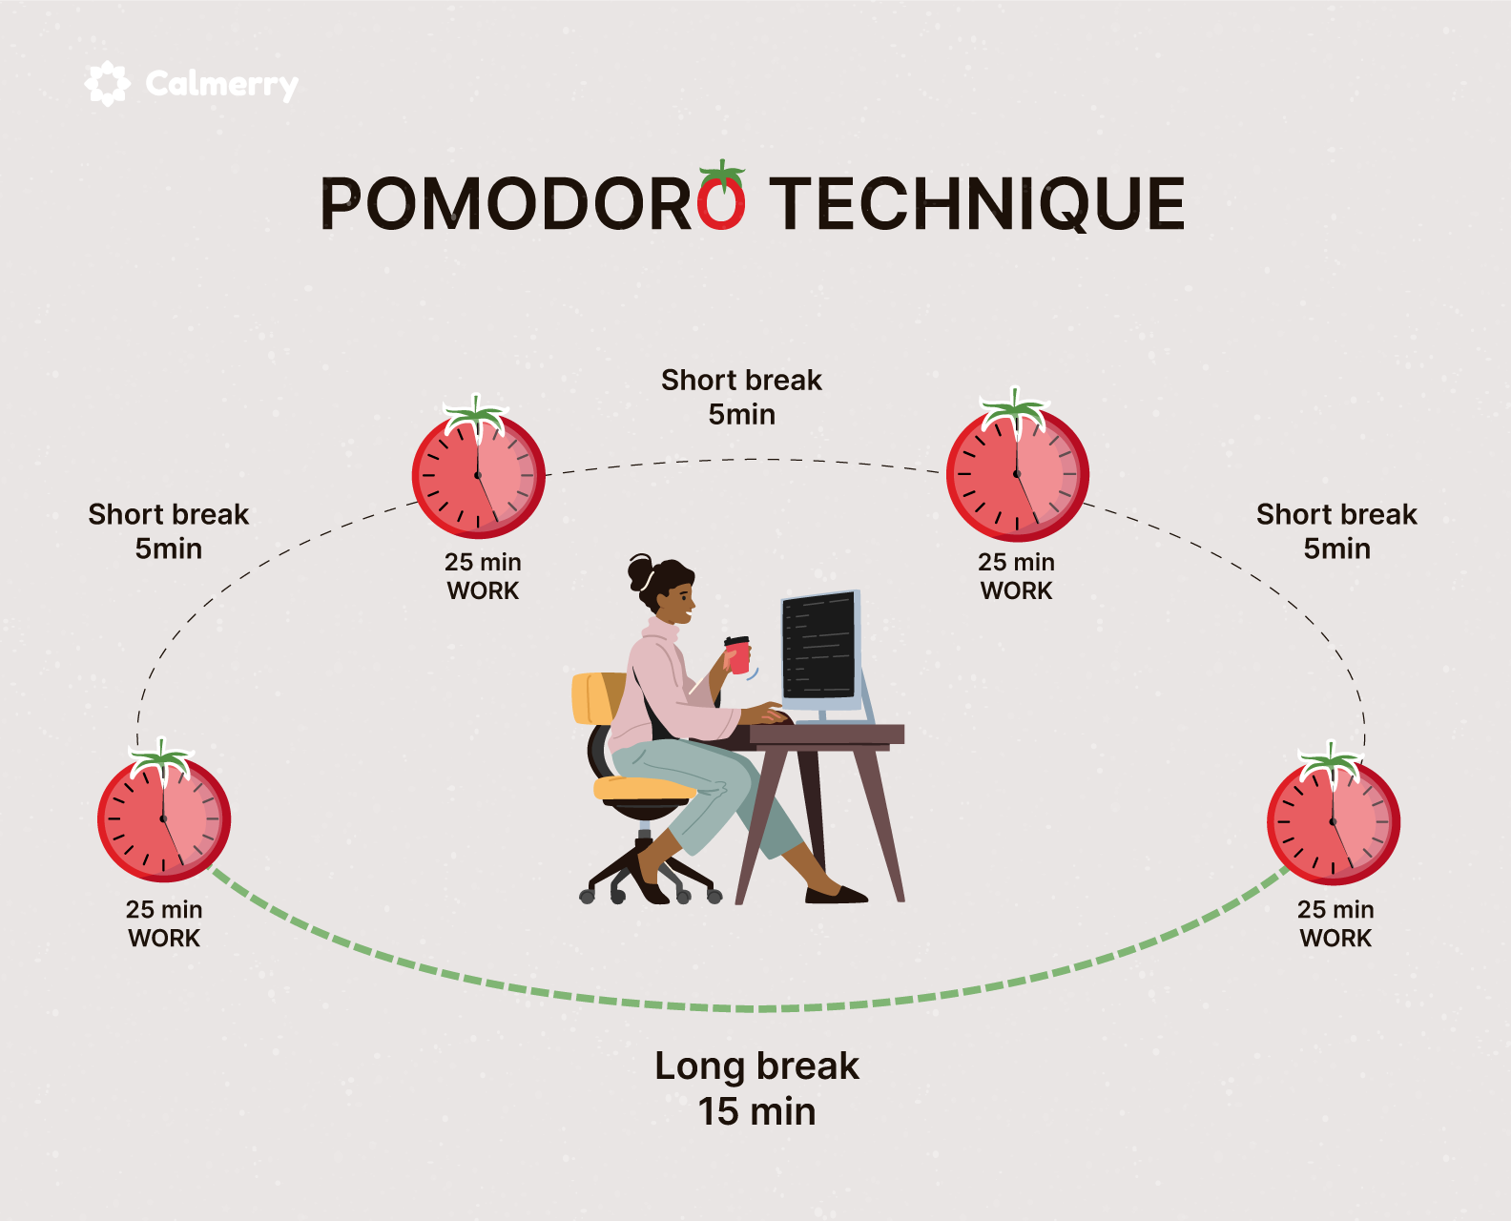

Slide 27
Mental Rest
Create a shutdown ritual to separate work and life
Notepad by the bed for nagging thoughts
Take a break from problem-solving
Brain-breaks (Schedule them. Use Pomodoro)
Music, silence, journaling
Notes:
You might also keep a notepad by the bed to jot down any nagging thoughts that would keep you awake

Slide 28

Emotional rest deficit occurs when you feel like you can't be authentic.
Compassion Fatigue
Emotional Rest
Notes:
Ex: An airline attendant who must always smile, despite rude passengers.
Truthful no but reluctant yes

Slide 29

Emotional Rest
Spend time with people you can be authentic around
Respectfully decline
Try speaking with a therapist to release emotional labor
People pleasing
Notes:
Ex: An airline attendant who must always smile, despite rude passengers.
Truthful no but reluctant yes

Slide 30

Creative Rest
Important for anyone who must solve problems or brainstorm new ideas
Appreciate beauty in any form, whether natural or human-created.

Slide 31

Creative Rest
Natural
Take in a sunrise or sunset
Go for a walk in nature
Be childlike and reawaken wonder
Human-created
Visit a museum or art festival
Engage with inspiring music, books, documentaries

Slide 32
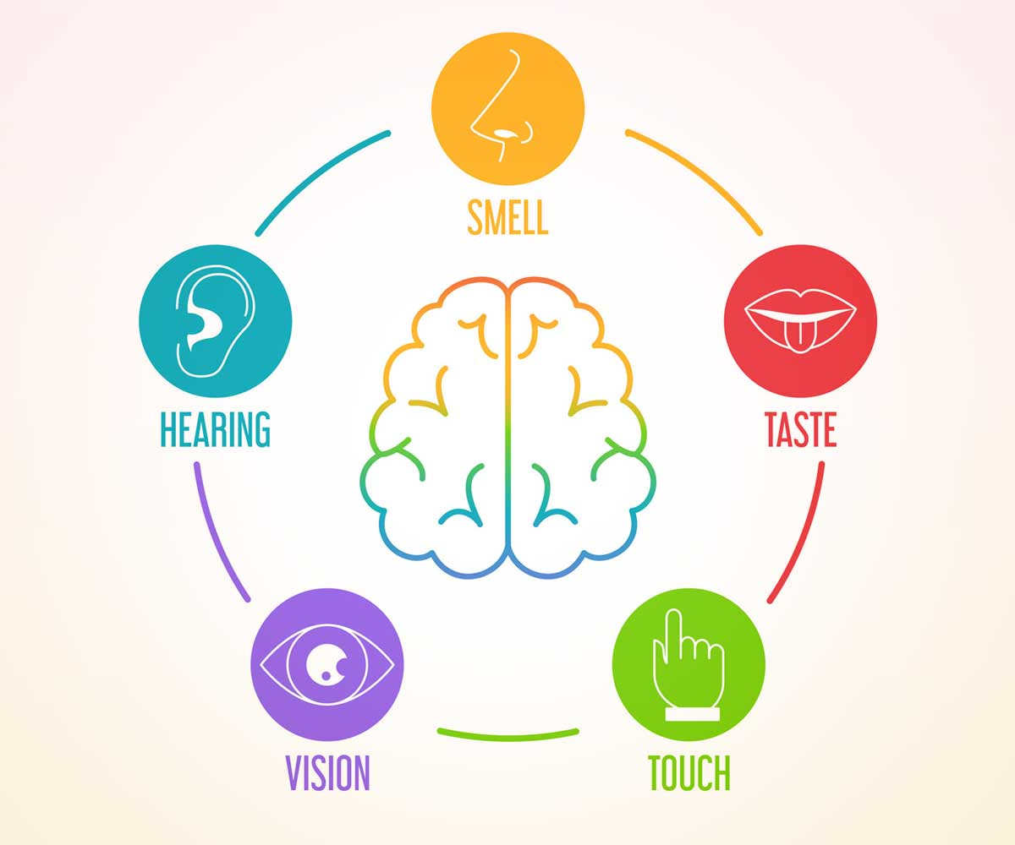
Sensory Rest
The modern individual is overstimulated.
Eye exhaustion resulting from marathon screen time sessions: digital eye strain

Slide 33

Sensory Rest
Take a break from social media
Turn off notifications (sounds and visual alerts)
Limit video meetings
Set a relaxing evening ambiance (soothing music, candles)
Turn down lights
Digital Detox

Slide 34

Social Rest
Evaluate your relationships!
(Revive or Exhaust?)

Slide 35

Social Rest
Spend more time with people who give you energy and provide support
Spend less time with people who steal your energy
If you're an introvert, block out time to be alone.
Fill your own battery

Slide 36

Spiritual Rest
Ability to connect beyond the physical and mental and feel a deep sense of belonging, love, acceptance and purpose

Slide 37



Spiritual Rest
Do things that provide a meaning.
Be part of something bigger than yourself.
Volunteer
Work a job that feels purpose-driven
Participate in faith-based activities (if aligned to your belief system)

Slide 38
Incorporating the 7 Types of Rest into Your Life
Incorporating all seven types of rest into your life may seem daunting, but it is essential for your overall well-being. Here are some tips on how to incorporate these seven types of rest into your life:
Schedule it in: Make rest a priority in your life by scheduling time for each type of rest. Just like you schedule time for work or exercise, schedule time for rest.
Be intentional: Be intentional about the type of rest you choose and make sure it aligns with what your body and mind need.
Take breaks: Take short breaks throughout the day to rest your body and mind. Go for a short walk, meditate, or just take a few deep breaths.

Slide 39
Incorporating the 7 Types of Rest into Your Life
Incorporating all seven types of rest into your life may seem daunting, but it is essential for your overall well-being. Here are some tips on how to incorporate these seven types of rest into your life:
Schedule it in: Make rest a priority in your life by scheduling time for each type of rest. Just like you schedule time for work or exercise, schedule time for rest.
Be intentional: Be intentional about the type of rest you choose and make sure it aligns with what your body and mind need.
Take breaks: Take short breaks throughout the day to rest your body and mind. Go for a short walk, meditate, or just take a few deep breaths.
Set boundaries: Set boundaries around your time and energy. Learn to say no when you need to, and don’t be afraid to ask for help when you need it.
Disconnect: Disconnect from technology and social media regularly to give your mind a break from constant stimulation.
Experiment: Experiment with different types of rest and find what works for you. Everyone’s needs are different, so find what brings you peace and incorporate it into your routine.
Make it a habit: Make rest a habit in your life. Incorporate it into your daily routine and make it a part of your self-care practice.

Slide 40

Takeaways
REST = RESTORATION
Dr. Dalton-Smith recommends starting with your 1-2 biggest rest deficits
Don’t try to eat the whole elephant at once
Then, over time, create daily and weekly habits to get all 7 (habit stacking)

Slide 41
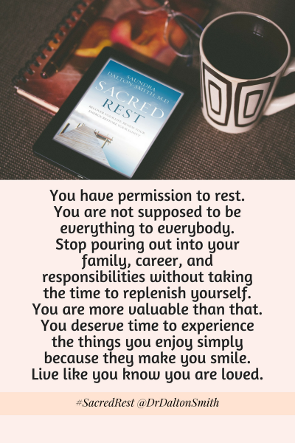

Slide 42
Inspiration :Dr. Saundra Dalton-Smith https://www.youtube.com/watch?v=ZGNN4EPJzGk&t=6s
Helping organizations overcome burnout, decrease employee turnover, and cultivate
a well-being culture featuring her proprietary 7 Types of Rest framework.
Notes:
“In SACRED REST, Dr. Dalton-Smith takes readers on a restorative journey. It’s a roadmap to healing that you never knew you needed … and a pathway to the serenity you’ve been longing for.”

Slide 43
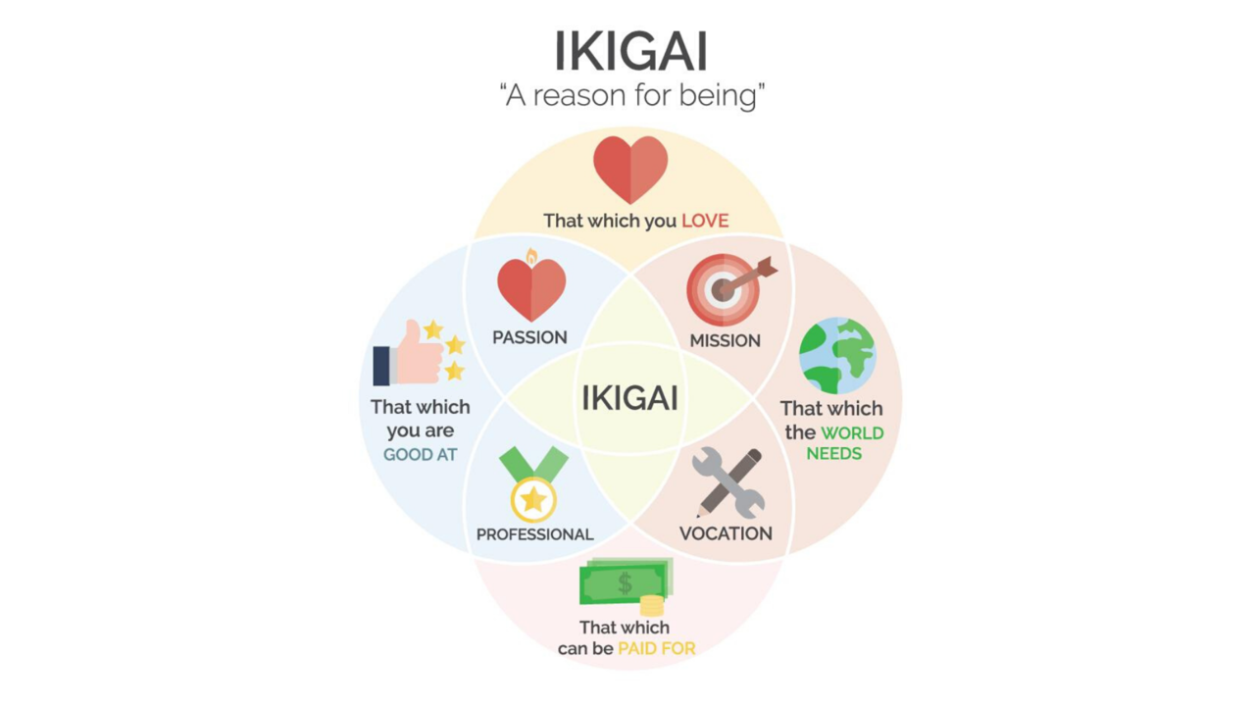
Notes:
If time permits

Slide 44
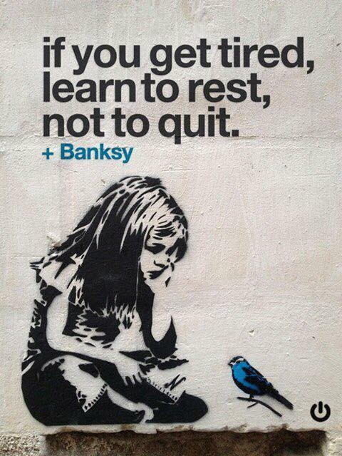

Slide 45

Set Boundaries, Find Peace: A Guide to Reclaiming Yourself

Slide 46


Thank you
P.S. Fatigue can also be associated with numerous health problems, so please get checked out by your physician if it persists.

Slide 47

Be healthy both mentally and physically

Slide 48


